Slide 1


Slide 3

ACES
BIM – Building Information Modelling
How to deliver BIM
11th September 2014

Slide 4



Agenda
John Sharp
Director
Chair of ESCC BIM Group
Owen Cockle
BIM Consultant
BIM level 2 overview and requirements,
Assets / Estate Information requirements to Employer information requirements
Employer information requirements to Assets / Estate Information requirements
Case study
Benefits of BIM and Q&A.

Slide 5
BIM Definition
Acronym for….
Building Information Modelling
or
Building Information Management
or
Business Information Management
or
Building Information Modelling and Management BIM(M)
      Many definitions
      Mean different things to different people
  At it’s core
It’s a managed approach to the collection and sharing of information across the whole project team.

Slide 6
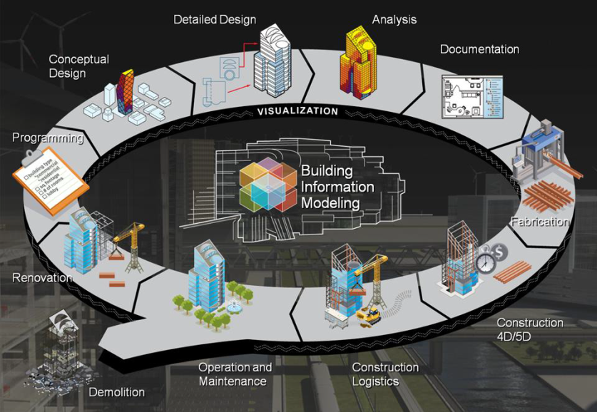
What is BIM?
What is BIM?
BIM is essentially value creating
collaboration through the entire lifecycle
of an asset, underpinned by
the creation, collation and
exchange of shared 3D models and
intelligent, structured data attached
to them.
BIM is not just a 3D model.
It is defined as “file based collaboration and library management.”

Slide 7
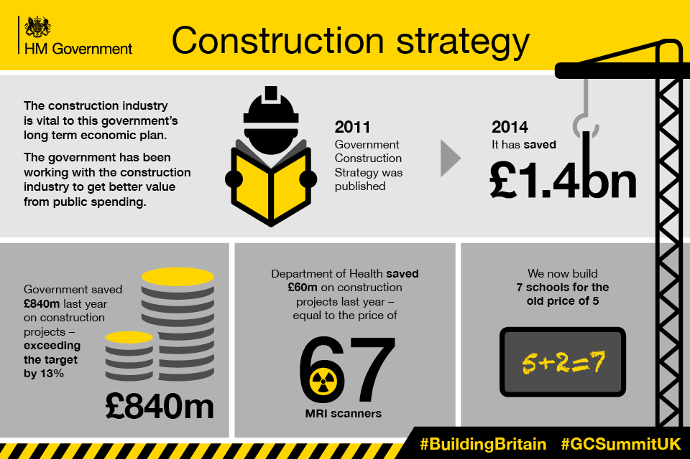
Why use BIM?
BIM is a requirement under the Government Construction Strategy (GCS)
https://www.gov.uk/government/publications/government-construction-strategy
BIM is mandated on all Central Government funded projects and is required to be implemented by 2016.
Local Government and other Public sector bodies are not mandated (currently) unless the funding is via central government however, they are strongly recommended to use BIM due to the benefits.

Slide 8
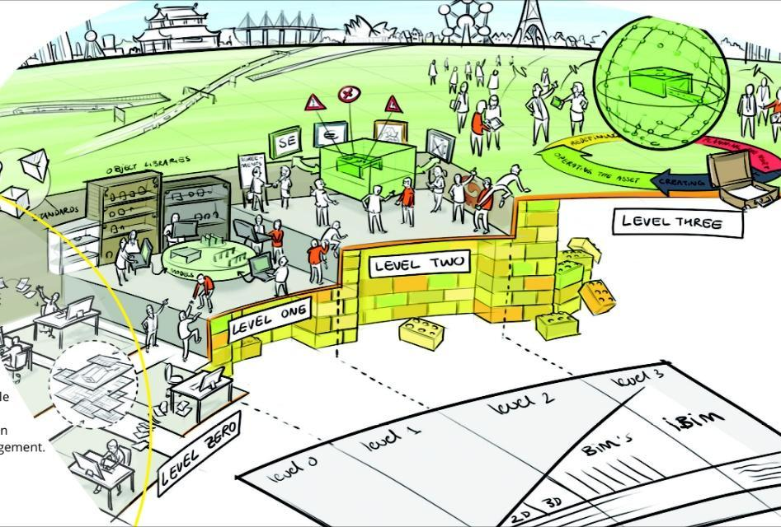
BIM Levels
Level 0 – Unmanaged 2D CAD with paper (or electronic paper) data exchange
Level 1 - Managed CAD in 2D or 3D format with a CDE
Level 2 - A managed 3D environment with separate BIM tools and attached Data following level 2 requirements
Level 3 - A fully integrated and collaborative process enabled by 'web services'

Slide 9
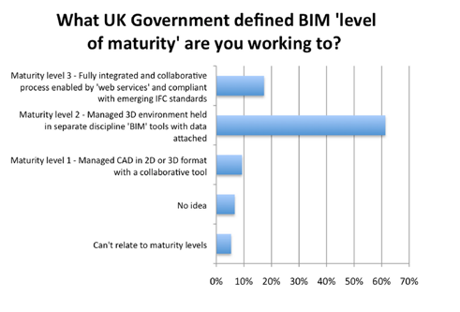
Where do we think we are?
CIBSE BIM Survey 2013 findings

Slide 10
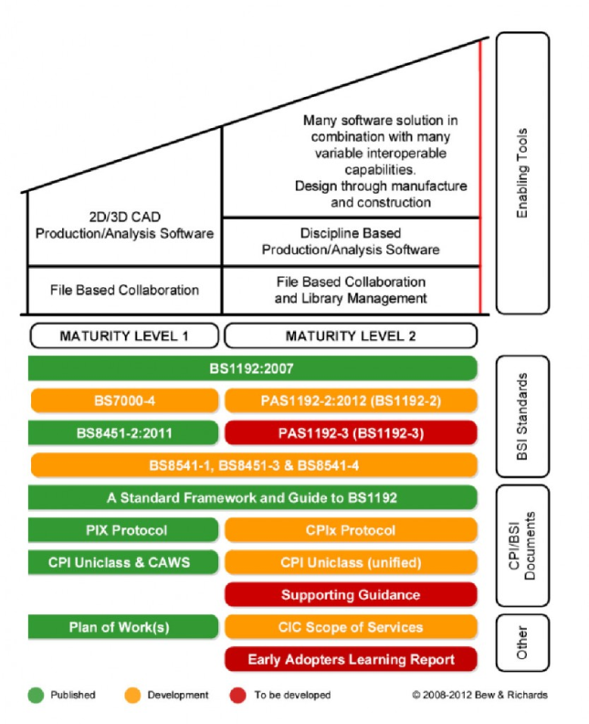
Where we actually are:
BIM Level 2 cannot be currently achieved
To achieve level 2, the following document requirements are required to be met:
PAS 1192:2 2013 (BS1192:2007)
PAS 1192:3 2014 (BS1192:2007)
CIC CPIx BIM Protocol
Government Soft Landings (GSL)
CoBie 2012 – to be up-dated to BS 1192:4 2014 – To be released towards the end of the year
UniClass2 (CPI) & Supporting Guidance – to be released during March 2015
Digital Plan of Work (dPOW) & Level of Detail (LOD) – To be released towards the start of 2015

Slide 11
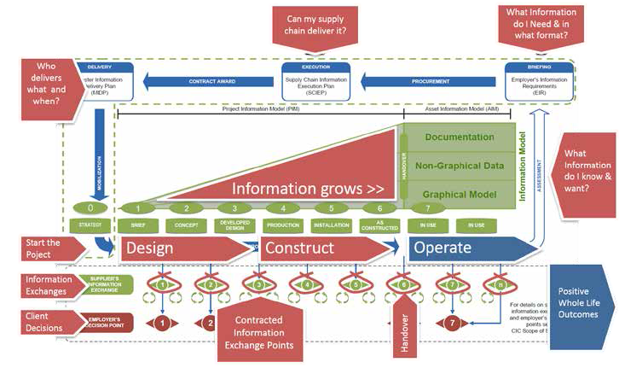
BIM Information Cycle
Project Information Model (PIM)
Asset Information Model (AIM)

Slide 12
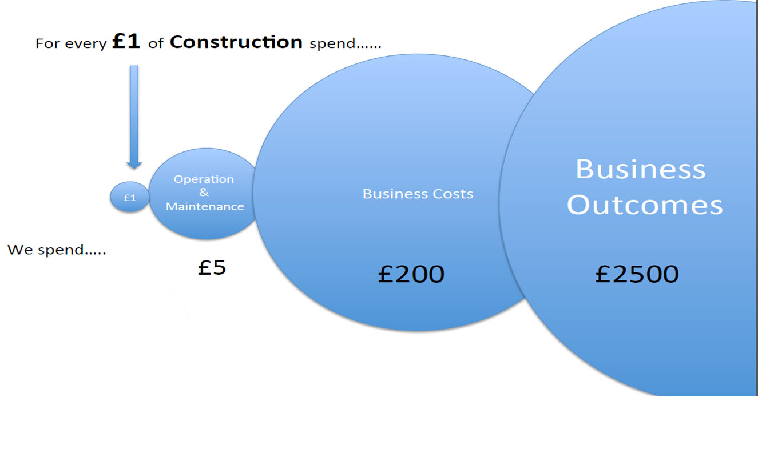


Construction Spend
For every £1 of Construction spend …..
Clients spend …..

Slide 13
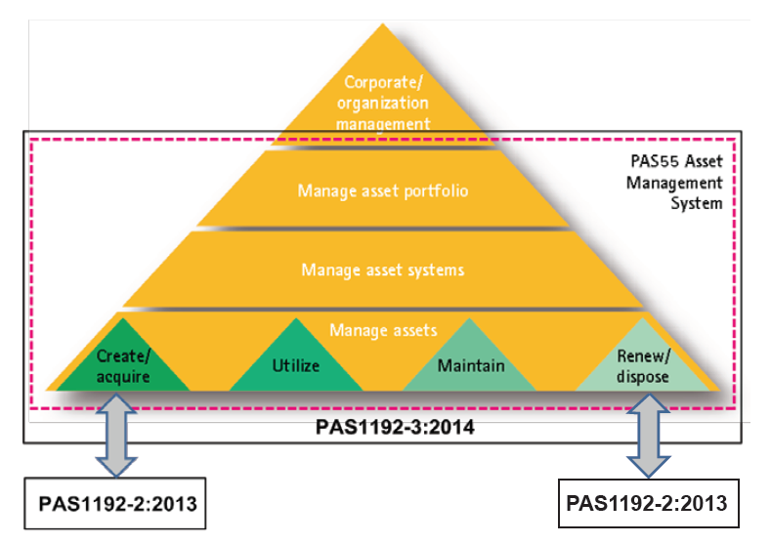
Operation – In Use – stage ‘n’
What information do I need to operate assets efficiently?
Organizational Information Requirements (OIR)
Facilities Management
Energy Management
generates
Asset Information Requirements (AIR)
Maintenance Management
Document Management
informs
Employer’s Information Requirements (EIR)

Slide 14


Operation – In Use – stage 7
Government Soft Landings (GSL)
Making assets work harder from day 1
  Initial Aftercare
  User Inductions / Training
  Assist FM team with building operation
  On-site attendance
  Communication with stakeholders
  Observe the building in use
  Extended Aftercare
  Environmental & Energy Performance – TM22
  Annual reviews
  Seasonal commissioning
  POE – Post Occupancy Evaluations

Slide 15
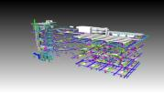



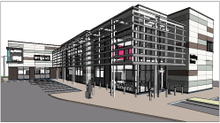

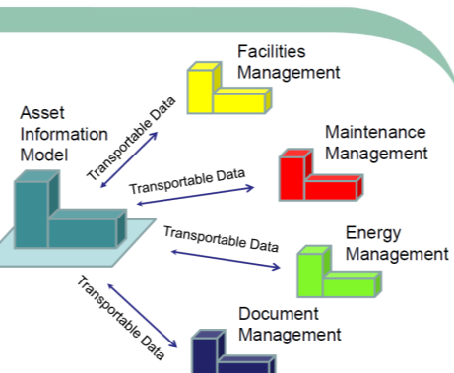
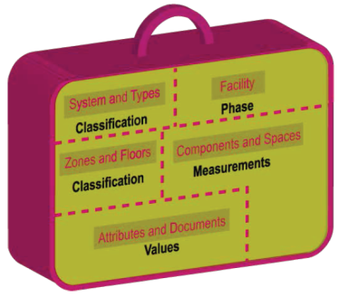
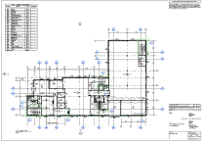
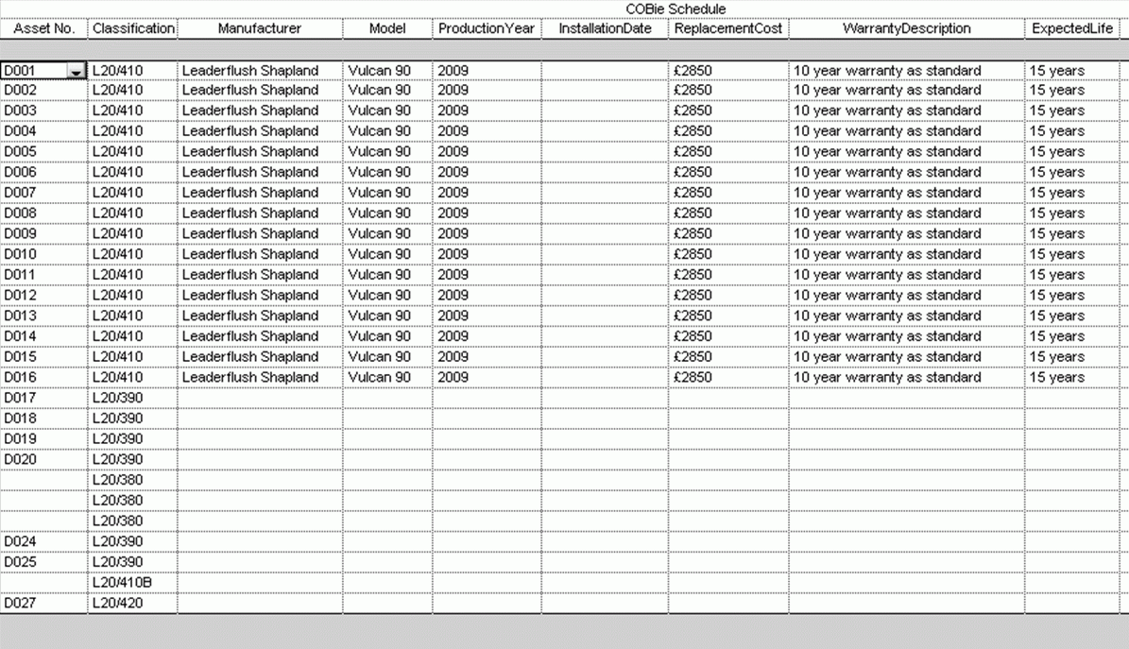
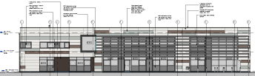
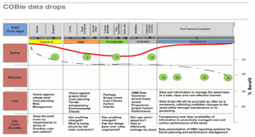
Handover – stage 6
Federation Model in both Native and IFC formats
Asset Information Model (AIM)
Unified Uniclass utilised for asset classification
COBie-UK 2012
2D PDF Drawings at Level of Model Definition (LOD) 6

Slide 16
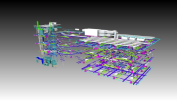

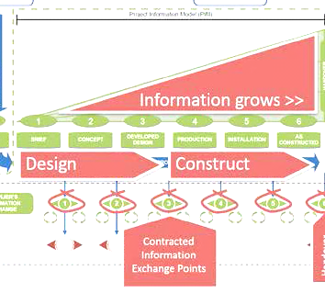

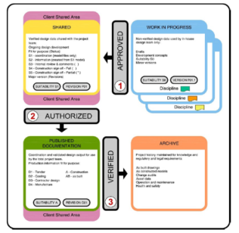







Design & Construction – stage 1 to 6
Project Information Model (PIM)
Models
BIM Execution Plan (BEP)
Common Date Environment (CDE)
Standards
4D
5D
6D
7D

Slide 17
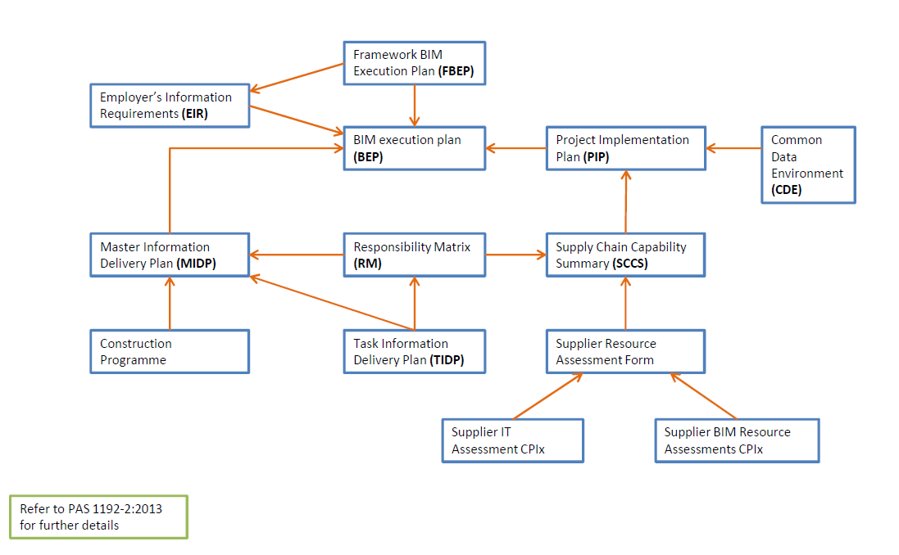
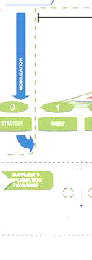
Design & Construction – stage 1 to 6
BIM Execution Plan (BEP)
Asset Information Requirements (AIR)

Slide 18

Strategic Brief – Stage 0
a) Information management:
1) levels of detail
2) training requirements
3) planning of work and data segregation
4) co-ordination and clash detection
5) collaboration process
6) HSE/CDM requirements
7) a schedule of any security and integrity requirements for the project;
8) a schedule of any specific information to be either excluded or included from information models;
9) a schedule of any particular constraints
10) compliance plan
11) a definition of any co-ordinate origin/system
12) a schedule of any software formats
b) Commercial management:
1) exchange of information
2) client’s strategic purposes
3) a schedule of any software formats
4) an initial responsibility matrix
5) a schedule of the standards and guidance documents used to define the BIM processes and protocols to be used on the project;
6) a schedule of any changes to the standards
c) competence assessment:
1) details of the competence assessment
2) changes to associated tender documentation
3) BIM tender assessment details
Employer’s Information Requirements (EIR)
Organizational Information Requirements (OIR)
generates
Asset Information Requirements (AIR)
informs
Employer’s Information Requirements (EIR)

Slide 19
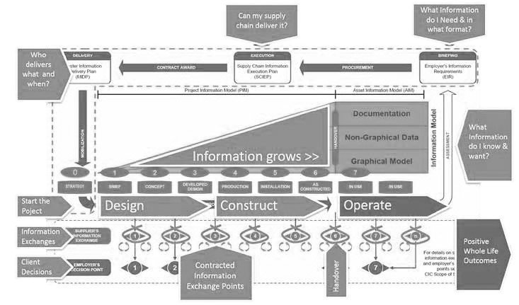
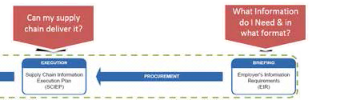
BIM Information Cycle
Project Information Model (PIM)
Asset Information Model (AIM)

Slide 20
Strategic Brief – Stage 0
Employer’s Information Requirements (EIR) – Client Brief
Define Requirements
Supplier IT Assessment CPIx
Supplier BIM Resource Assessments CPIx
Supplier Resource Assessment Form
Supply Chain Capability Summary (SCCS)
Establish EIR’s
Employer’s Information Requirements
Out to Tender / Issue prior to Project Start

Slide 21
Strategic Brief – Stage 0
Employer’s Information Requirements (EIR) – Tender Return
Employer’s Information Requirements
Construction Programme
Supplier IT Assessment CPIx
Supplier BIM Resource Assessments CPIx
Outline Master Information Delivery Plan (MIDP)
Outline BEP / PIP / CDE
Supplier Resource Assessment Form
Outline Responsibility Matrix (RM)
Supply Chain Capability Summary (SCCS)
Tender Return / Issue prior to Project Start
Tender Evaluation

Slide 22
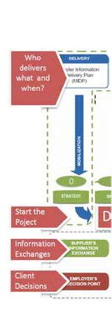
BIM Information Cycle
Project Information Model (PIM)
Asset Information Model (AIM)

Slide 23
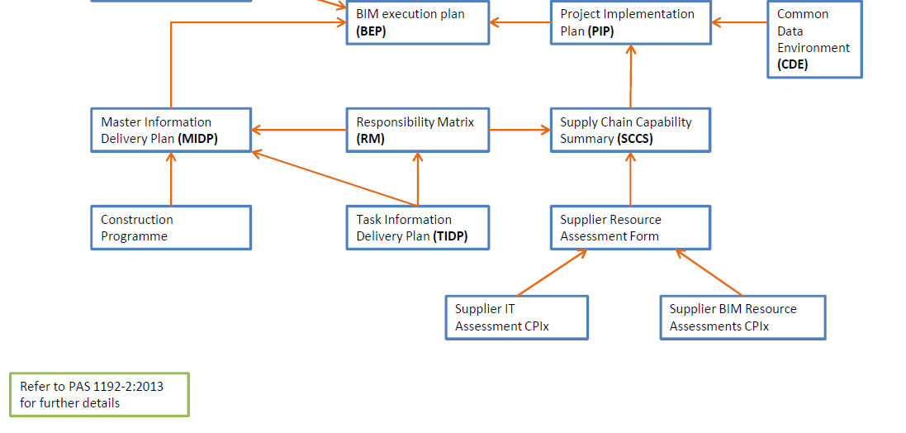
Strategic Brief – Stage 0
BIM Execution Plan (BEP) – (by Consultants / Contractor)
Standards
The BEP is a Live Document that should be up-dated to project handover

Slide 24
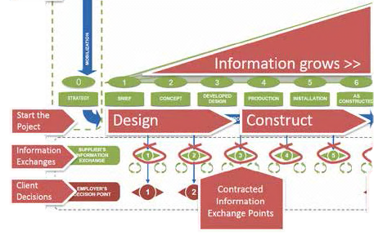
BIM Information Cycle
Project Information Model (PIM)
Asset Information Model (AIM)

Slide 25




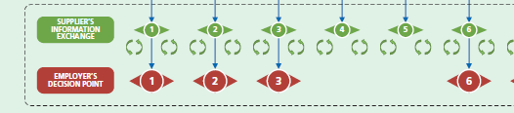
Design & Construction – stage 1 to 6
Project Information Model (PIM)
BIM Execution Plan (BEP)
Common Date Environment (CDE)
Models
4D
5D
6D
Standards
7D

Slide 26

BIM Information Cycle
Project Information Model (PIM)
Asset Information Model (AIM)

Slide 27
Handover & In Use – stages 6 & 7
Project Information Model (PIM)
Federation Model in both Native and IFC formats
Unified Uniclass utilised for asset classification
Government Soft Landings (GSL)
Making assets work harder from day 1
COBie-UK 2012
2D PDF Drawings at Level of Model Definition (LOD) 6
Asset Information Model (AIM)

Slide 28
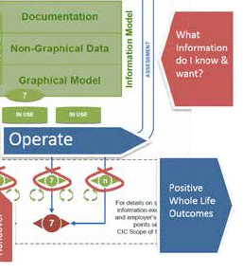
BIM Information Cycle
Project Information Model (PIM)
Asset Information Model (AIM)

Slide 29
Next Steps
Keep it simple but ensure the EIR’s are well defined.
Use industry standard templates (CIC)
Useful information can be found at - http://www.bimtaskgroup.org/
Contacts:
John Sharp Owen Cockle
Director BIM Consultant
Pick Everard Pick Everard
0845 234 0884 0845 234 0884
johnsharp@pickeverard.co.uk owencockle@pickeverard.co.uk

Slide 30
ACES
BIM – Building Information Modelling
London Borough of Hounslow Schools – A BIM Case Study
11th September 2014

Slide 31
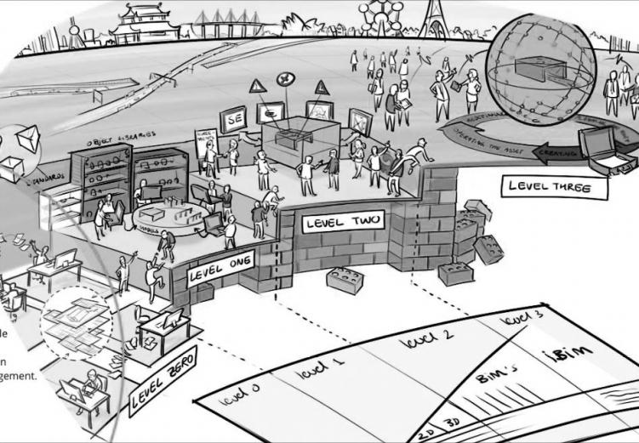

BIM Level Definition : A Quick Reminder
Level 0 – Unmanaged 2D CAD with paper (or electronic paper) data exchange
Level 1 - Managed CAD in 2D or 3D format with a CDE
Level 2 - A managed 3D environment with separate BIM tools and attached Data following level 2 requirements
Level 3 - A fully integrated and collaborative process enabled by 'web services'

Slide 32

BIM Level Definition : A Quick Reminder
Level 0 – Unmanaged 2D CAD with paper (or electronic paper) data exchange
Level 1 - Managed CAD in 2D or 3D format with a CDE
Level 2 - A managed 3D environment with separate BIM tools and attached Data following level 2 requirements
Level 3 - A fully integrated and collaborative process enabled by 'web services'
2016
All Centrally funded Projects

Slide 33
BIM Level Definition : A Quick Reminder
Level 0 – Unmanaged 2D CAD with paper (or electronic paper) data exchange
Level 1 - Managed CAD in 2D or 3D format with a CDE
Level 2 - A managed 3D environment with separate BIM tools and attached Data following level 2 requirements
Level 3 - A fully integrated and collaborative process enabled by 'web services'
Pick Everard
Level 2 Capable*
(*using existing standards due to be updated)

Slide 34
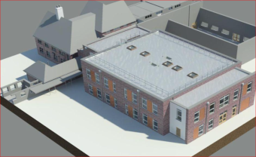
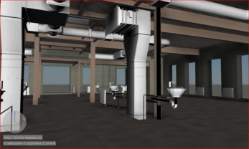
London Borough of Hounslow – A BIM Case Study
FELTHAM HILL JUNIOR
SCHOOL, HOUNSLOW

Slide 35
London Borough of Hounslow – A BIM Case Study
Client: London Borough of Hounslow
Project: Feltham Hill Junior School extension
Description: New two-storey, eight-classroom teaching block
Services: Project Management, Cost Management and Full Design Team
Location: Hounslow, London
Project Value: £3.2m
Delivery Date: Ongoing

Slide 36
London Borough of Hounslow – The Employers Requirements
Description and challenges
Our brief is to deliver this new build extension as part of a wider programme comprising £150m of school construction projects in the borough.
Working to a tight budget across the programme,
achieving cost savings through accelerated delivery programmes has been paramount, making this project and others ideal for the use of BIM and a Common Data Environment to provide efficiencies in the coordination and delivery of the design.
Minimising the impact of the new block on the
existing building and keeping the footprint of the newbuild low were key requirements which, through an integrated approach involving all parties targeting BIM Level 1, helped us design the new two storey accommodation at the rear of the building.
to virtually simulate the appearance of building
An external finish in keeping with the surrounding
residential area and to the satisfaction of
stakeholders was achieved through BIM. Using 3D
Revit models, we were able to demonstrate our
design virtually—showing precisely how it would
look when built.
With sustainability and renewables high on the
client’s agenda, the use of BIM and 3D modelling
has helped us to conceive a design with low
embodied carbon, integration of efficient systems
and reduced waste, with whole life energy use
considered rather than taking a short-term
approach.
20+ Similar Projects
Tight Budget/Programme
Energy modelling with the same model used to design the building
A need for an Integrated approach

Slide 37
London Borough of Hounslow – Project Achievements
Project Achievements
Delivery of a robust BIM Execution Plan providing clear roles and procedures.
Cost savings through an accelerated programme facilitated by BIM working.
High levels of collaboration between design team members through information sharing.
Increased capacity to meet client’s design requirements through 3D modelling.

Slide 38
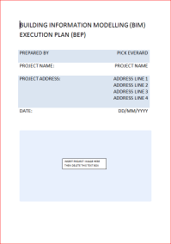
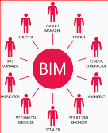
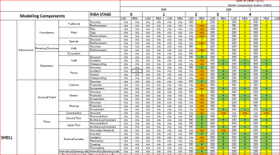

London Borough of Hounslow – BIM Planning
BEP
BIM Execution Plan
The project has seen us adopt a detailed and robust BIM Execution Plan (BEP) to guide its delivery. Using the plan we have been able to:
Clarify lines of communication and the strategic goals of using BIM on the project
Assign and clarify the roles and responsibilities of design team members and supply partners
Outline the resource and training requirements needed for success
Provide a baseline for progress monitoring Goals established in the plan are set with measurable objectives, desired outcomes and timeframes, as shown in the examples on the next page.

Slide 39
London Borough of Hounslow – BIM Goals
BIM Goal | Measurable Objective | Achieved if | Projected Timeframe
Reduce cost through accelerated programme | Delivery timescales | Project delivered ahead of traditional programme | Completion of project
Meet all client requirements | Produce complete design in Intelligent BIM | Rework reduced and all deliverables met | Completion of project
Produce clash resolved model | All components clash free, or approved to reduce construction time | Clash free construction | Completion of project

Slide 40
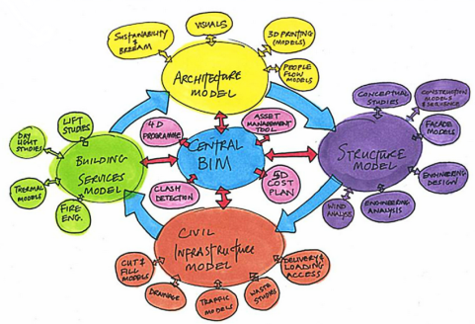
London Borough of Hounslow – Coordination
Coordination
The appointment of a Project BIM Coordinator has
provided a single point of contact whom the delivery
team and client team can consult with any relevant
queries or concerns. Their duty has been to oversee
the completeness and accuracy of the BEP and
overall project model, as well as coordinating all
updates to the model and database.
Supporting this have been Discipline Coordinators
with the responsibility to steer their relevant team
members in delivering according to the BEP. They
have acted as a liaison between the delivery team
and the Project BIM Coordinator.
Coordination
A Project BIM Coordinator – 1 Point of contact
BEP Completeness and accuracy
Task team coordinators (discipline leads)
Liaison between delivery team and Project BIM coordinator

Slide 41
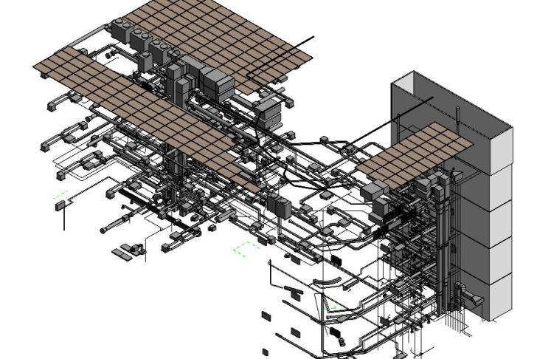
London Borough of Hounslow – Design Discipline Models
Building Services Model

Slide 42
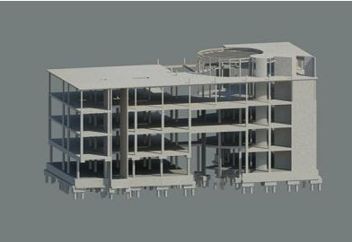
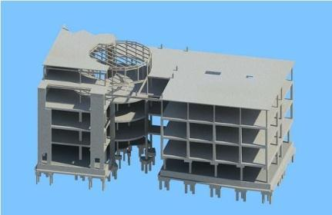
London Borough of Hounslow – Design Discipline Models
Structural Model

Slide 43
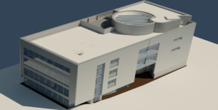

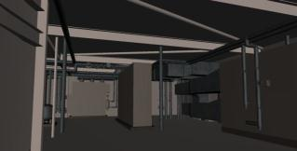
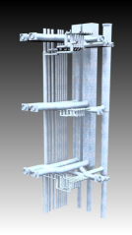
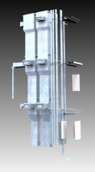
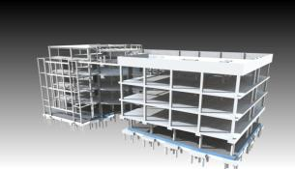
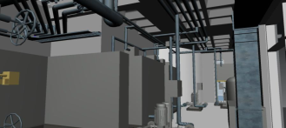
London Borough of Hounslow – Design Discipline Models
Arch Model
MEP Model
Plantroom
Plantroom
Structural Model
Mechanical Risers

Slide 44
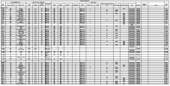

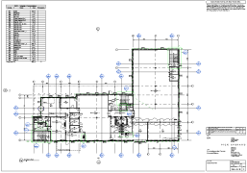

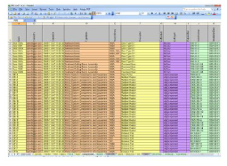

London Borough of Hounslow – 2d Deliverables from the BIM

Slide 45
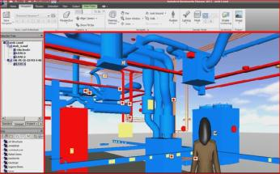
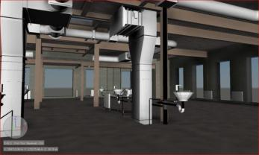
London Borough of Hounslow – Clash Detection
Clash Detection
Clash detection is the responsibility of all project
stakeholders. Each Discipline BIM Coordinator
checks for interferences or conflicts after integrating
the models from other disciplines with their own.
These are then issued for review with the aim of
resolving any clashes so that defects are avoided
during the construction phase.
This takes place at meetings for which minutes are recorded and issued to the delivery team and supply partners to act on.
This must be carried out as set out in the BEP before
sign off can take place.
It is Each Disciplines’ Responsibility to clash check own model against other disciplines models
Clashes recorded, issued and tracked for action
All Carried out as agreed in the BEP
BIM Execution Plan

Slide 46
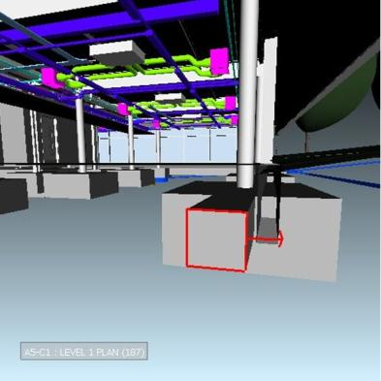


London Borough of Hounslow – Clash Prevention

Slide 47


London Borough of Hounslow – Clash Prevention

Slide 48


London Borough of Hounslow – Visualisation
Render from Revit
Photo from completed building

Slide 49


London Borough of Hounslow – Visualisation
Render from Revit
Photo from completed building

Slide 50


London Borough of Hounslow – Visualisation
Render from Revit
Photo from completed building

Slide 51


Stourbridge College – Brierley Hill Campus
BIM Benefits : Visualisation
Render from Revit
Photo from completed building

Slide 52




London Borough of Hounslow – A BIM Case Study
The Common Data Environment is…..
“a single-source of information for any given project, used to collect, manage and disseminate all relevant approved project documents for multidisciplinary teams in a managed process”. It may use a project server, extranet, a file-based retrieval system or other suitable toolset.
(BS1192:2007)

Slide 53

BIM Benefits: Common Data environment
Traditional working

Slide 54

BIM Benefits: Common Data environment
Level 2 BIM working

Slide 55
Lesson learnt – Pick Everard Architects Experience
Pros:
Facilitated easier and more effective communication
Increased Knowledge of other disciplines design development.
More immediate visual feedback of design decisions – Walkthroughs, Renders.
Quicker design decisions driven by energy analysis.
Quick, high quality views were always available.
Efficiency of scale, repeatability (30+ similar school projects)
Cons:
EIRs or Employers Information Requirements were not sufficiently developed to allow timely BIM execution planning.
3d Point Cloud surveys and existing BIM models generated form them, unrelaiable.
Significant rework needed to produce reliable existing models.
Design And Build procurement route did not make sufficient allowance for Level of detail, sequence and delivery of BIM project information.

Slide 56
Top Benefits Reported…..So far
Easier and more effective communication
Lower construction costs
Fewer errors
Less rework
Increases co-ordination of documents
Improves productivity due to easy retrieval of information

Slide 57
Questions?
Questions?

Slide 58
www.pickeverard.co.uk

Slide 60

A Bilfinger Real Estate
company
ACES Conference
Asset Management and Valuation Workshop
Thursday 11th September 2014

Slide 61



Panel
John Jones
National Senior Director
GVA
Benjamin Moorhouse
Director – Asset Management
GVA
John Wood
Co-Founder
The Other Retail Group

Slide 62
Introduction
Does your organisation have a property asset management plan or a strategic plan?
Have you been asked to prepare an up to date plan?
When was the previous plan conceived and issued?
What is an asset management?
There is a housing shortage
There are still more cuts to come
There is an ‘late’ Autumn statement coming up
The Scottish referendum YES or NO?
2015 election

Slide 63


Remember 2007?
Lehman Brothers
Recession
Debt
Austerity
Euro crisis
Retail closures
Energy prices
Climate change
Terrorism

Slide 64









What was then?

Slide 65










So what’s new?

Slide 66





The commercial property market
Speculative development
Speculative investment
London is ever growing – the residential express train
Regional growth – core cities
Student housing and PRS

Slide 67






The commercial property market
Shorter flexible leases
SME growth
The knowledge economy
Click and collect – logistics and delivery
Leisure, food, entertainment & football
Destination and place making – new BIDS
Energy and alternatives

Slide 68
Property asset management
So in the period since 2007 the environment in which any organisation operates has changed considerably
Property is a powerful force in organisational change
Property assets are an important part of the way organisations support and enable transformation of service delivery
Property should be managed effectively to provide best value for services and customers
Property portfolios are a valuable resource, but can cost considerable sums to manage and maintain
Best value includes social, economic and environmental benefit

Slide 69
Public sector property asset management
Property asset management in the public sector has focused on reducing the cost base and production of savings.
But the management of a property portfolio can play a significant role in regeneration & growth, service delivery and operational quality and efficiency.
Manage assets differently
Manage effectively
Manage risk
Manage for regenerate and growth
Manage the environment

Slide 70
Property strategy
Define the objectives
Services, service delivery and infrastructure
Customers and stakeholders
Capital receipts and income growth
Regeneration, social improvement, employment
Additional housing provision and development
Environmental improvement and welfare
Risk management

Slide 71
Property action
Property ownership and date management
Property database for analysis, valuation and reporting
Operational property, income producing or surplus
Property team – roles, responsibilities and capacity
Property management policy and strategy
Treasury services, risk management and legal services
Procurement policy
Outsourcing, partnerships and specialists
Timescales, flexibility, agility and change

Slide 72

A Bilfinger Real Estate
company
Ben Moorhouse
Director
Asset management – driving value
Thursday 11th September 2014

Slide 73
Market dynamics – drivers of value
Location
Sector/planning use
Macro/micro market factors
Income/longevity of income
Tenant covenant
Physical condition
Void costs/service charge levels

Slide 74
Investment value considerations
Triple net return – most important
Total Income less non recoverable costs less void cost (rates, insurance & S/C)
Rebased rents – evidence
Deliverable cashflow
Building condition
2013 #1 reason for price adjustment
Vendor’s survey should have costings
Service charges
Balanced budgets

Slide 75
Investment value considerations
Arrears
Underwriting of rental income
Rates
Unrecoverable cost mitigation
Development viability/local authority
Development cost to income returns
Planning flexibility – A3, leisure, hotel, residential

Slide 76
Asset management – good practice
Formulate and deliver appropriate strategy
Secure and enhance income returns
Market awareness/sector specialists
Longevity and level of income v ERV
Manage voids and void costs
Marketing
Physical condition
Planning use
Redevelopment/refurbishment
Service charges
Obsolescence
Special interests

Slide 77

A Bilfinger Real Estate
company
John Wood
The Other Retail
Group
Retail asset managers
Thursday 11th September 2014

Slide 78
Town centre asset management
Vision
Understanding of the requirements
Understanding of the systems
Understanding of operations
Delivery

Slide 79
Key issues for consideration
Rateable values and rate charges
Approval process
External voices - consultation
Funding
Getting to the point of agreement

