Slide 1
Working with Croydon
Nick Royle, Head of North America FDI Team

Slide 2
Who are London & Partners?
The organisation
Formed in April 2011 x 125 employees
London & Partners is the official promotional organisation for London.
We are a not-for-profit public private partnership, funded by the Mayor of London and our network of commercial partners.
Five business lines: Attracting FDI, Students, Tourists, Conventions, Major Events.
Economic Development support/GLA

Slide 3
FDI Sales Scope and remit
  Priority Markets FDI & Core Sectors
    Primary
    North America
    (USA & Canada)
    EMEA
    France
    Spain
    Germany
    Asia Pacific
    India
    China
    Japan
    Australia
    Secondary (multiplier engagement in London)
    Latin America (Brazil & Mexico)
    Italy
    Netherlands
    Nordics
    Singapore
    Middle East
    Other (reactive only)

Slide 4
DELIVERING VALUE FOR LONDON
FOREIGN DIRECT INVESTMENT
CONVENTIONS/ MAJOR EVENTS
Spike in 10-11 is due to 3 large expansion projects (Nomura, Apple and Bank of America)
LEISURE TOURISTS
INTERNATIONAL STUDENTS
Notes:
FDI activity continues on an upward trend with a forecast of completing over 250 investment projects creating 4402 jobs (192 projects, 3853 jobs to date)
Spike in 10-11 is due to 3 large expansion projects (Nomura, Apple and Bank of America collectively accounting for c.2000 jobs)
Tech City
London & Partners has also been actively promoting the capital's emergence as Europe's leading digital city, jointly with the Mayor of London and the Tech City Investment Organisation. Over the last year, we have helped more than 130 overseas tech business set up in the capital, including high profile names such as Yammer, Yelp, and Twitter.
Twenty of those companies have set up in Tech City, Europe’s fastest growing tech cluster located in east London. We will continue to promote this growing cluster through targeted activity in our core markets, plus we will be leveraging Tech City to support a major new digital summit and showcase which will reinforce the Capital’s technology positioning.
Royal Docks
We have helped secure multiple EOI’s from China however only one Chinese bidder, namely Dauphin Holdings Group Ltd, shortlisted along with seven other shortlists.
As a part of core team and working very closely with LDA and its agents, we assisted with marketing the site internationally, and generated significant interest in Royal Albert Dock, most notably from China but also from Australia, India and the US. We have incorporated Royal Docks messaging in all of our major international sales pitches for last year, in particular a joined up GLA/LDA/L&P sales pitch in September in China as well as other China based sales campaigns. We helped identifying multiple Chinese parties expressing an interest in developing Royal Docks and secured one Chinese bidder shortlisted for the development. Through these involvements London & Partners contributes to creating growing international confidence in the future of the Royal Docks as a whole.
Oxylene/Decathlon
Think London was working with Oxylane since 2007 about the legacy opportunities in the park. We have been continuing to support them since, which has included facilitating an introductory meeting with OPLC through to most latterly with the Mayor’s Health Advisor, Sir Peter Rogers and the department of Health.
Oxylene will be presenting their bid for the International Broadcast Centre OPLC tomorrow. The concept is to combine retail with sports, community, leisure, entertainment and commercial with an emphasis on encouraging people to engage in physical activity.
The scheme will include:
Commercial office space including:
Business Incubation Centre
Administration headquarters of Oxylane UK
Sport England/UK Sport Head Offices
Head office of a number of sport’s governing bodies
A Sports and Health Research & Development Centre, in conjunction with Loughborough University
A Sports Academy, offering an extensive range of indoor sports facilities, in conjunction with the FA, Hackney Marshes and the tenant of the Olympic Stadium
Decathlon Sports Retail Store
In-Quest – A unique and immersive leisure experience that combines physical team challenges with puzzle solving in a controlled environment
Sporteezy – a fun, accessible and inclusive way for the community to enjoy sport
Medical Centre
Spa and Gymnasium
Food Court and a diverse range of eateries
Creche / Drop-In Centre
The main merits of the scheme are:
they have a tried and tested business plan and product
the plan involves sport, the community, business and academia
it can operate as a hub for other legacy opportunities on the park
it drives participation in grass root sports, is accessible and affordable
it meets the health and obesity agenda by targeting some of the 50% of adults in London who are classed as inactive
they have finance in place
the development will create 1,500 long term jobs in East London
OPLC appear very supportive - Andrew Altman visited their premises in Lille for a day and is hosted their worldwide board on a tour of the park on the 18th of March
the scheme can be delivered quickly (within 27 months)
Loughborough partnership is a good academic one and adds real credibility
it still leaves the Press Centre for technology companies to occupy office space
The scheme is contestable with other UK locations and without the Olympic Park the development is highly unlikely to happen in London.
Succesful investments include
We successfully completed a joint PR campaign with the TCIO for a client who we helped set up in Tech City – Yammer.
Yammer (www.yammer.com) is the leader in enterprise social networking, providing a secure way for employees to communicate, collaborate, and share information. The basic version of Yammer is free, and customers can pay to upgrade their network to receive additional administrative and security controls, priority customer service and a dedicated customer success manager. More than 80 percent of the Fortune 500 using our award-winning Software-as-a-Service (SaaS) solution to improve employee productivity and engagement. Visit our blog to see how our customers are benefiting from Yammer.
Haier
Haier has been on our Most Wanted Customer List for a while and a breakthrough to secure its commitment to London only came after we visited them at its global headquarters in Qingdao, China as part of our Expo Sales Campaign last year. After the visit there have been many rounds of discussions took place. Through thorough research and business advisory pieces, we successfully convinced Haier that, West London provides a strong foundation for future Haier UK to grow from, not only for better access to its client base, channel partners and 3PL providers, as well as by staff, but also for ease of draw on talents from wider regions to create sustainable competitive edges. We recommended that West London also cater Haier’s property requirements in terms of costs and other locational considerations. Leveraging our relationship with the Home Office, we helped on visa applications of Haier’s key personnels. We maintained an extensive amount of communications with the client, arranged many business meetings and peer learning for them, helped them get access to 2012 business opportunities, and assisted in growing their business networks in London. Commented on the value-add of London & Partners’ contribution, the client said in its plain language “[e]ven we want to be in London as the first choice, price is always a problem, with London & Partners, we found the best balance“. It went on, “[we] get to the right contact in various business sector, providing business opinions and network”.
Twitter
London and Partners prepared a research report to include the UK Online & Mobile Advertising Sector, London as an EHQ, office options and Tech City. We conducted a property tour, made introductions to Head of Digital for LOCOG, BBC Digital team and companies in our networks to support their activities in UK and Europe and potential candidates to assist with recruitment. We also introduced professional service providers to advise on legal, banking, insurance, office search, relocation and residential accommodation. Tony Wang stated "Twitter would be in London but it would have been more painful [without London and Partners]"
Business Tourism
Confirmed bookings is on an upward trend with significant increase in 2011-12. BT is an area which has historically been under-invested by Visit London and we increased resource this year.
Won:
European Association of Urology, 14000 delegates
European Renal Assoc 10000 delegates
Europerio 2015 (Periodontology) – 5000 delegates
(Demonstrates strength of medical congresses – makes up 85% of all major events won by Excel)
Also won Cisco Live from Barcelona and World Islamic Investment Forum
Business tourism have confirmed business of £103.2m of which £39.5m is 2012 business, this against a total target of £85m – 121% of target.

Slide 5
A STRATEGIC PROMOTIONAL FRAMEWORK
Position London as the world capital of business
Attract foreign direct investment and events which support the growth of world class business clusters
Help maintain and grow London’s position as the best location for European and Global HQs and the world’s leading financial centre
Help London businesses to access global value chains
Support efforts to enhance London’s favourable business environment and reduce barriers to growth
Position London as the world’s leading centre for talent and creativity
Associate London with its world class academic institutions, foremost innovators and business leaders
Attract new leading academic and research centres
Reduce barriers which limit the capital’s ability to attract, retain and develop talent
Position London as the world’s top visitor destination
Give visitors compelling reasons to come, and return, to London
Work with partners to maintain the Capital’s unique, exciting visitor experience
Turn visitors into ambassadors
Maximise London’s positive exposure during the Olympic and Paralympic Games
Deliver maximum economic value for the London economy

Slide 6
How we assist client companies
FIND THE PROPERTY
& LOCATION
YOUR
BUSINESS
CASE
FIND THE
RIGHT PEOPLE
FIND THE PROPERTY
& LOCATION
EXPAND YOUR
LOCAL
NETWORK
YOUR
LONDON
- Sector Intelligence
- Legal Requirements
- Corporate/Tax Structure
- Cost-effective Set-up
- Specialist Recruitment
- Funding & Training
- Salary Benchmarking
- Employment Practice
- Office Specialists
- Market, Clients &
Transport
- Labour Pool
- Demographic Mapping
- Professional Service
- Events
- Government Contacts
- Policy-makers
- Culture & Social Life
- Visas & Work Permits
Schools & Colleges

Slide 7
Our clients in Croydon since 2008
Costco store -wholesale club/retail x 250 initial* jobs
Clas Ohlson - retail x 70 jobs
Baierl & Demmell - Construction x 5 jobs
DHC Corporation -Logistics x 15 jobs
Atkins Engineering x 10 jobs
Everfocus -ICT x 8 jobs
NavSoft –ICT x 5 jobs
Docs Corp Pty -ICT x 5 jobs
* Year 1 figure

Slide 8
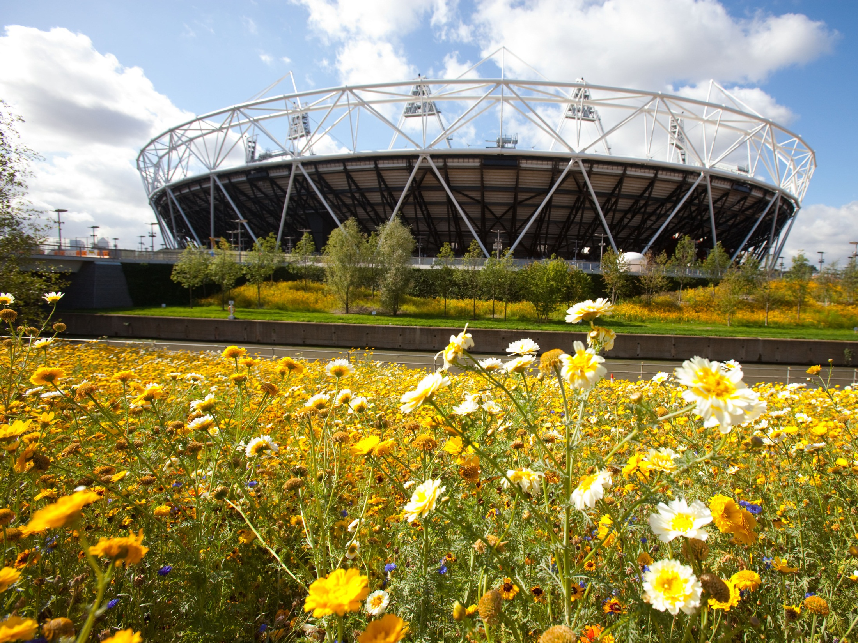

LEVERAGING THE
2012 GAMES – Leading the Mayor’s Games Time Business Hospitality Programme
Notes:
London ideal city to cater for your entire programme
Presidents / Welcome reception (350)
St Paul’s cathedral
London transport museum
Museum of London
London gala dinner (6,000)
Excel – London’s largest banqueting hall
Faculty dinner (400)
Painted Hall Old Royal Naval College
Guildhall

Slide 9
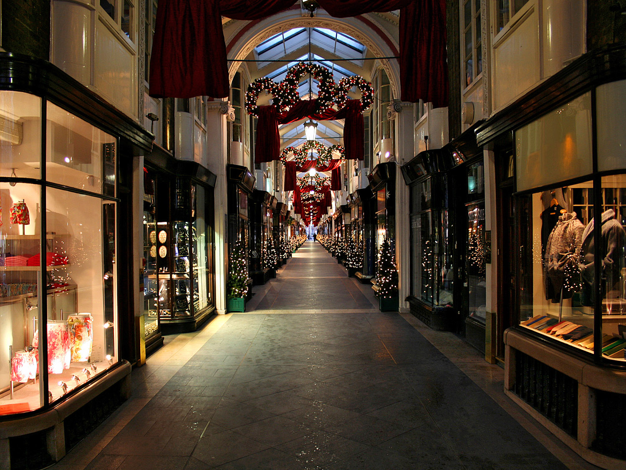
QUESTIONS &
ANSWERS
Notes:
Museums and galleries
London is home to more than 200 museums and galleries hosting everything from blockbuster art shows to crowd-pulling interactive displays. Start with the world-famous Tate Modern art gallery, the British Museum and the Victoria and Albert Museum and plot your route from there
Heritage and days out
Popular attractions include the London Eye, Buckingham Palace, Hampton Court Palace, Westminster Abbey, the Tower of London, the Royal Botanic Gardens at Kew, Greenwich’s Royal Observatory and the Houses of Parliament.
Europe’s best nightlife
Around half a million people go clubbing in London every Saturday night. Choose from superstar DJ hangouts such as Pacha, Fabric and the Ministry of Sound to cutting-edge smaller venues such as Favela Chic and 333.
Theatre and music
Choose from more than 100 venues from West End musicals to Chekhov at the Royal Court, opera at the Hackney Empire, hilarious acts at the Comedy Store and contemporary dance at Sadler’s Wells. London is home to five symphony orchestras, two leading opera houses and a huge choice of concerts at multi-arts centres such as the Barbican, the Royal Albert Hall and the Southbank Centre.
http://www.royalalberthall.com/
Shopping
Choose from big names such as Harrods, Selfridges, Fortnum and Mason, Liberty’s and Lilywhites, vibrant markets including Portobello Road, Spitalfields and Camden, and some of the world’s most fashionable shopping areas such as Covent Garden, Kings Road and New Bond Street
Beautiful parks
Green space makes up some 30% of London, with the royal parks of Kensington Gardens, Regents Park, Hyde Park, St James Park and Richmond Park among the most popular. Boating lakes, zoos, open-air theatres, fountains, lidos, woodland and sports grounds abound.
Unrivalled sport
Spectator highlights include tennis at Wimbledon, football at the new Wembley Stadium, cricket at Lords, rugby at Twickenham, racing at Ascot and, in 2012, the Olympics at Stratford.
Festivals and events
Highlights include the Notting Hill Carnival, Chinese New Year celebrations, the Oxford and Cambridge boat race, the London marathon, Chelsea Flower Show, Trooping the Colour, the BBC Proms, Open House architecture week and the London Jazz Festival.

Slide 10
Contact Details
Email to: nroyle@londonandpartners.com
Direct Telephone – 020 7234 5744

